Slide 1
Bowling Buddy
Spencer Lyons
@Spencer30 (github)
https://www.bowling-buddy.com

Slide 2
Description
Bowling Buddy is a stat tracking app for bowlers who are looking to improve their game. Bowling is a challenging sport to become consistent at. Bowling Buddy helps users see where they are struggling and which areas to focus on in practice.

Slide 3
Features
Create An Account
Enter your pinfall while you’re bowling
Change the ball used, the alley you bowled at and the type of game play
Review your games. See your score, ball used, alley and game type
See your stats for all your games – Average, Strikes, Spares, Open Frames
Manage your settings – edit, add or delete balls, alleys and game types

Slide 4
Planning - User Stories
I just got back into bowling and joined a bowling league. I was struggling to become consistent and really felt like I was letting the team down.
I wanted something that I could track my scores and stats to see where I needed to improve during practice.
I didn’t want to download a complex app but just wanted to see at a high level how I am progressing. I knew I had to try to keep the app as simple as possible.

Slide 5
Planning - Database
Bowling Buddy is using MySQL database. It currently has 6 tables :
Users – stores the user name, email, and hashed password
Games – stores the all the games, userID, score, and ball, alley, game type and frames ID
Balls – stores the ball name and userID
Alleys – stores the alley name and userID
Game Type –stores the type of game bowled and the userID
Frames – stores every single frame bowled and the game ID is associated with

Slide 6
Technology Stack
Node.js
React.js & Express.js
MySQL
React Router, JWT, bcrypt, Recharts, Axios, Moment.js, Bootstrap
Hosted on Heroku

Slide 7
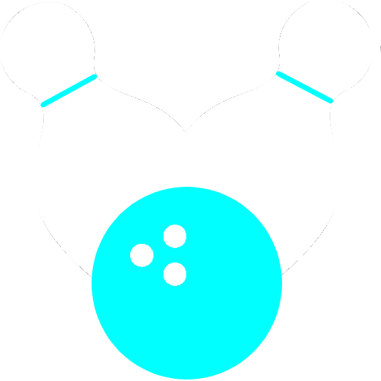
Demo

Slide 8
What I Learned
React.js – Got a solid understanding of the library, especially Hooks
Authentication / Authorization – used JWT & Local Storage
MySQL – design, implementing and querying

Slide 9
What’s Next
Drill down on user stats – i.e. filter on one type of ball to see your stats
The UI, while functional, isn’t the prettiest. I would like to work with a designer to restyle the app. Which will give me the experience of coding based off design specs.
Public Landing Page. This will give users an overview of the app without having to have an account.
Notes:
Be specific! If you mention another feature describe why that features is necessary, or what problem it solves. If you mention changing the UI mention specific technologies, or libraries you will use to do that. If you mention a technology, or feature you don’t know yet tell them how you plan on learning it.

